Slide 1
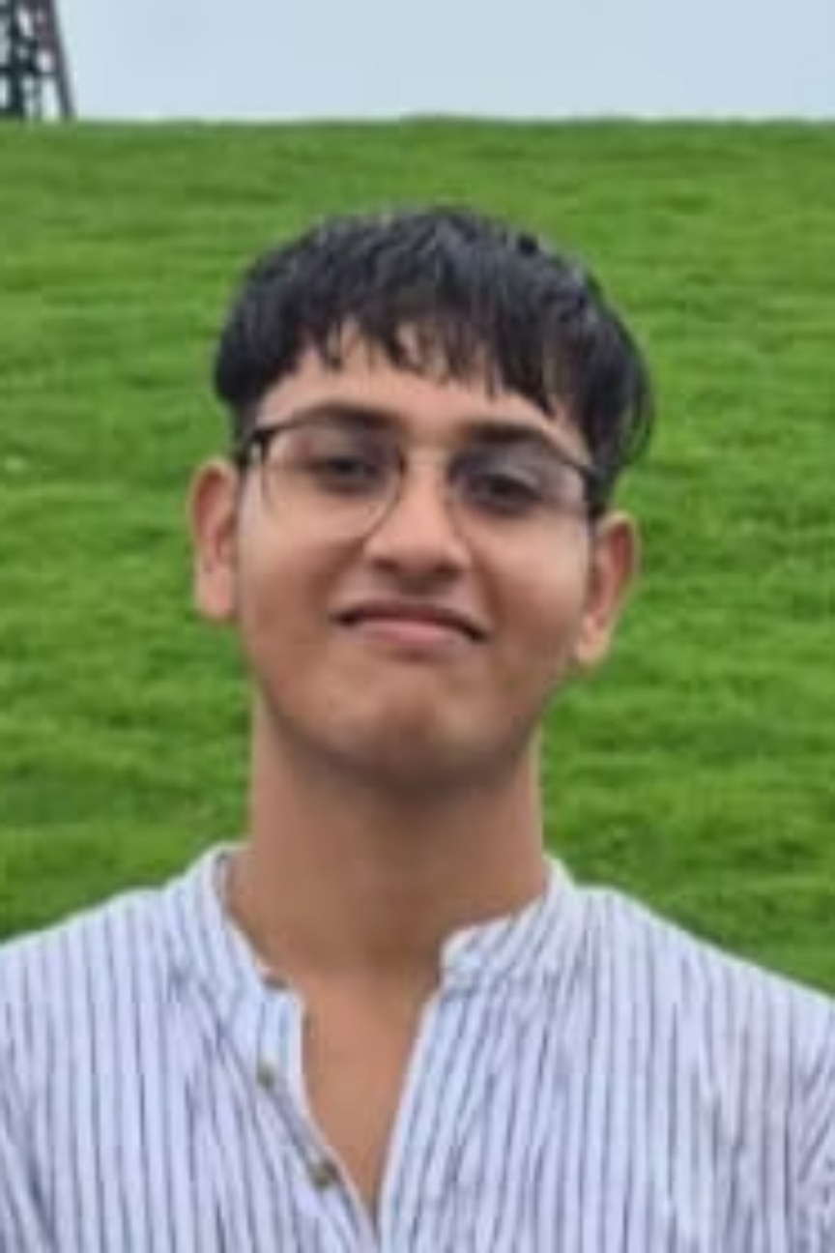


Abhranil Singha Roy
ComputerScience Undergrad||DevelopingCoreSkillsinAI, SDE & ML ||
Building Projects & Skills

Slide 2
About Me
I'maComputer Sciencestudentwith a strong passion for Artificial
Location
Intelligence, IoT, Robotics, Software Development & Machine Learning. I'm naturally curious, love solving problems, and enjoy understanding how things work—especially when it comes to building smart, efficient systems.
Kolkata, West Bengal, India
Languages
English (Professional) Hindi (Full Professional) Bengali (Native)
I bring energy, enthusiasm, and ownership into everything I do—whether it's a project, collaboration, personal growth or spontaneous trip. My mindset is all about learning, growing, and making an impact with positive energy.

Slide 3





What I Do
AI & ML Exploration
Problem Solving
ExploreandexperimentwithAI & ML models and algorithms to build intelligent
Applycuriosity-drivenproblem-solving to tech and real-world challenges.
systems.
Creative Teamwork
Balanced Living
Combinetechnicalskillswithcreativity and teamwork for impactful results.
Balancinglifewithpassions: gym, travel, riding, and pets.
IOT and Robotics
Engineerfocusedoncreating intelligent robotic and IoT systems that connect, automate, and inspire.

Slide 4

Current Focus
Strengthening Core Skills
BuildingexpertiseinPython,Java,C++, C#, JavaScript, HTML, TensorFlow, PyTorch, DSA and programming
fundamentals.
Active Collaboration
Engaginginexcitingtechprojects, internships, and hackathons to gain real-world experience.
Generative AI & LLMs
Exploringcutting-edgeGenerative AI and Large Language Models to stay ahead of innovation.

Slide 5

Technical Skills
Programming Languages
Python (Programming Language) C (Programming Language) Java, C++, C# JavaScript, HTML Java Script
AI & ML Frameworks
TensorFlow PyTorch Data Structures & Algorithms

Slide 6



Experience
1
ApnaCollege - Student
September2025 - Present
Learning Coding, DSA, Web development, Operating Systems
& Networking.
2
Hacktoberfest - SuperContributer
October 2025 Kolkata, West Bengal, India. Powered by DigitalOcean & MLH.
3
Elevate Labs - Python Developer (Intern)
November 2025

Slide 7



Education Journey
JIS University
Ramakrishna Vivekananda Mission
Bachelor ofTechnology - Computer
St. Luigi School
Science Engineering (August 2025 - April 2029)
Nursery(January2010 - December 2010)
KG,Primary, Secondary&Higher
Secondary - PCMB (January 2011 - May 2025)

Slide 8



Certifications & Achievements
1
TCS × E1133 Research Project
Completedadvancedresearchprojectincollaboration with TCS.
2
Gemini Certification
GeminiCertificationforUniversity Students - AI and ML specialization.
3
AWS Solutions Architecture (Forage)
AWSSolutionsArchitectureJobSimulation - Cloudcomputing expertise.
4
Electronic Arts Software Engineering (Forage)
ElectronicArtsSoftwareEngineeringJobSimulation - AIfocus.
5
Accenture Australia - Technology Consulting
ElectronicArts - SoftwareEngineeringJobSimulation(Forage)
6
Cybersecurity Analyst
CybersecurityAnalystJobSimulation (Forage)
7
Tata – Data Visualization & GenAI Data Analytics Job Simulation (Forage)

Slide 9



Why Work With Me?
Energy & Enthusiasm
Ownership Mindset
Continuous Learning
Ibringpositive energyand genuine enthusiasm to every project and collaboration.
Itake fullownershipof my work, ensuring quality and commitment in everything I do.
I value meaningful connections,
continuous learning, and personal growth in all aspects of life.

Slide 10



Let's Connect
I'malwaysexcitedtoconnectwithfellowtech enthusiasts, collaborate on innovative projects, or discuss opportunities in AI, ML, and
software development. Whether you're looking for a passionate team member or just want to chat about technology, I'd love to hear from you!
Email
LinkedIn
GitHub
abhranilsingharoy@gmail.com
linkedin.com/in/abhranil
github.com/abhranilsingharoy-cloud

